Slide 1


Slide 2

Concept Learning: The Quest for Rules
Embark on a journey into Concept Learning. Discover how machines acquire knowledge through rules. Learn how these rules shape artificial intelligence.

Slide 3
What is Concept Learning? Definition and Intuition
Definition
Intuition
Concept learning is acquiring a general definition of a category.
It involves identifying the key attributes that define the concept.

Slide 4
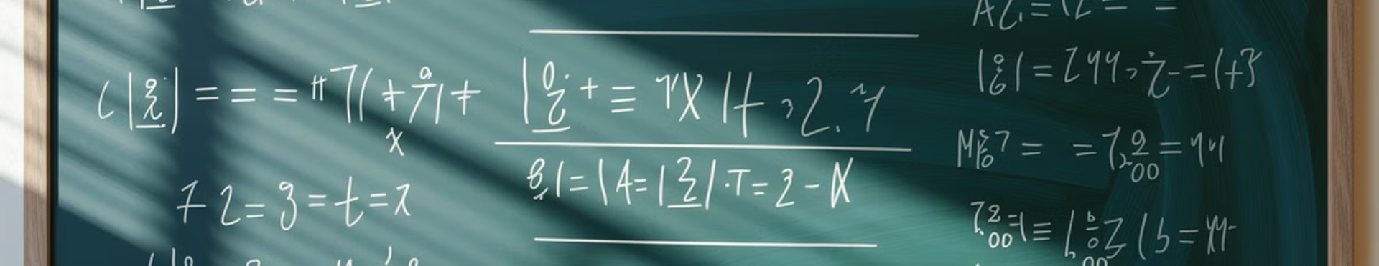
Rule-Based Learning: Formalizing Knowledge
1
Formal Representation
2
If-Then Statements
3
Logical Deduction
Knowledge is explicitly represented as rules.
Rules take the form of "IF condition THEN conclusion".
Inference is performed through logical deduction.

Slide 5

Example: Learning the Concept "EnjoySport"
Attributes
Target Concept
Sky, AirTemp, Humidity, Wind, Water, Forecast.
EnjoySport: Yes or No.
Task
Learn a rule to predict EnjoySport based on attributes.

Slide 6



Hypothesis Space: Defining the Possible Rules
Structured Space
Search
The hypothesis space consists of all possible rules.
Learning involves searching this space for the best rule.

Slide 7

Inductive Bias: Shaping the Learning Process
1
Definition
Assumptions made by the learning algorithm.
2
Constraint
It restricts the hypothesis space.
3
Generalization
It guides the algorithm to generalize correctly.

Slide 8




Find-S Algorithm: Finding a Maximally Specific Hypothesis
Initialization
Positive Examples
Negative Examples
Start with the most specific hypothesis.
Generalize the hypothesis to cover positive examples.
Ignore negative examples.

Slide 9



Candidate-Elimination Algorithm: Version Space Learning
Positive Examples
2
Generalize the minimally general boundary.
Version Space
1
Represent all consistent hypotheses.
Negative Examples
Specialize the maximally specific boundary.
3

Slide 10



Version Space: Representing All Consistent Hypotheses
Consistency
1
Hypotheses consistent with all training examples.
Boundaries
2
Represented by general and specific boundaries.
Learning
3
Shrinks with each example.
Version space keeps only the hypotheses that can correctly classify all training data. It narrows with each training example, retaining just the most plausible explanations.

Slide 11
Example Walkthrough: Candidate-Elimination in Action
Initial Version Space
1
All possible hypotheses.
Example 1
2
Update version space.
Example 2
3
Further refine version space.

Slide 12

Advantages of Rule-Based Learning
1
2
3
Interpretability
Transparency
Explainability
Easy to understand the learned rules.
The reasoning process is transparent.
Easy to explain why a decision was made.

Slide 13
Disadvantages and Limitations
Scalability
Complexity
Noise
May not scale well to large datasets.
Can be complex to design rules manually.
Sensitive to noisy data.

Slide 14
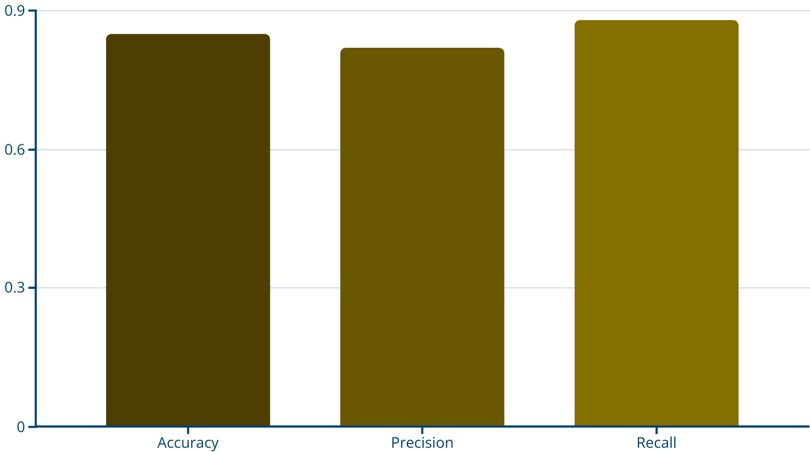
Decision Trees: A Rule-Based Learning Algorithm
A decision tree uses a tree-like structure to model decisions. This algorithm can be used for classification and regression tasks. The structure allows explicit representation of decision making rules.

Slide 15
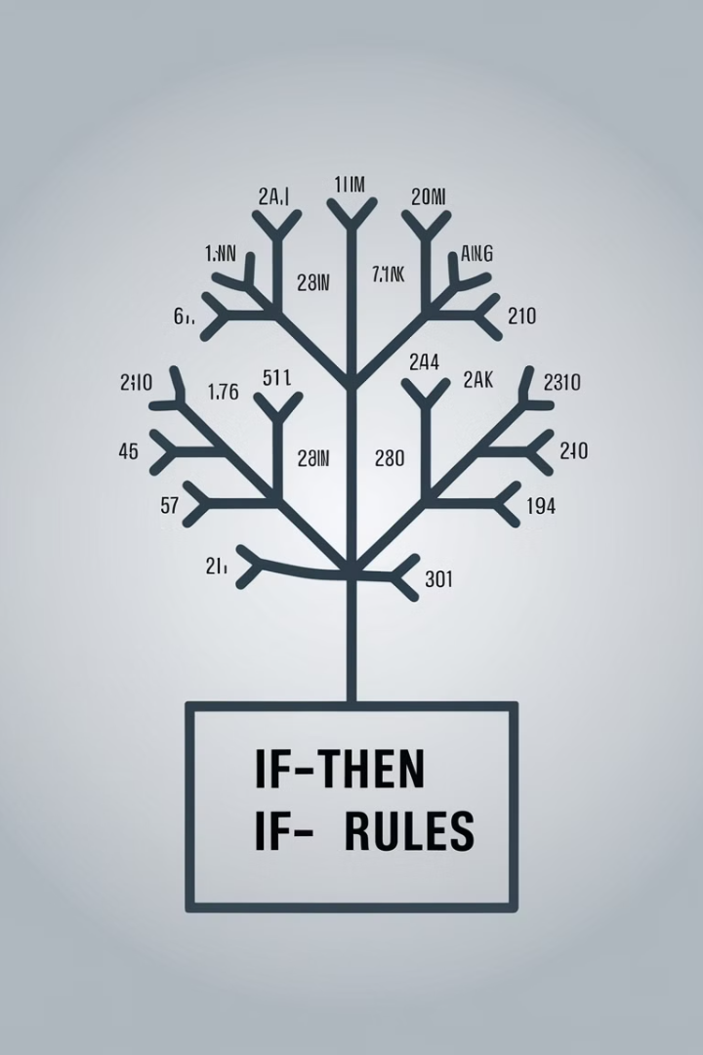
Rule Extraction from Decision Trees
Paths
Conditions
Each path from root to leaf forms a rule.
Nodes along the path represent conditions.
Conclusion
Leaf node represents the conclusion.

Slide 16

Python Code Demo: Implementing Find-S
def find_s(examples): h = examples[0][:-1] # Initialize with the first positive example for example in examples: if example[-1] == "Yes": for i in range(len(h)): if example[i] != h[i]: h[i] = "?" # Generalize if attribute values differ return h

Slide 17

Code Walkthrough: Step-by-Step Explanation
1
Initialization
Initialize hypothesis with the first positive example.
2
Iteration
Iterate through each example.
3
Comparison
Compare attribute values with hypothesis.
4
Generalization
Generalize hypothesis where attribute values differ.

Slide 18
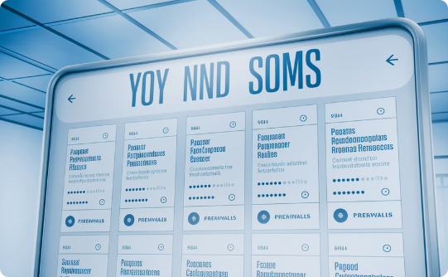


Real-World Applications of Concept Learning
Medical Diagnosis
Spam Filtering
Credit Risk Assessment
Diagnose diseases based on patient symptoms.
Identify spam emails based on content.
Assess creditworthiness of loan applicants.

Slide 19
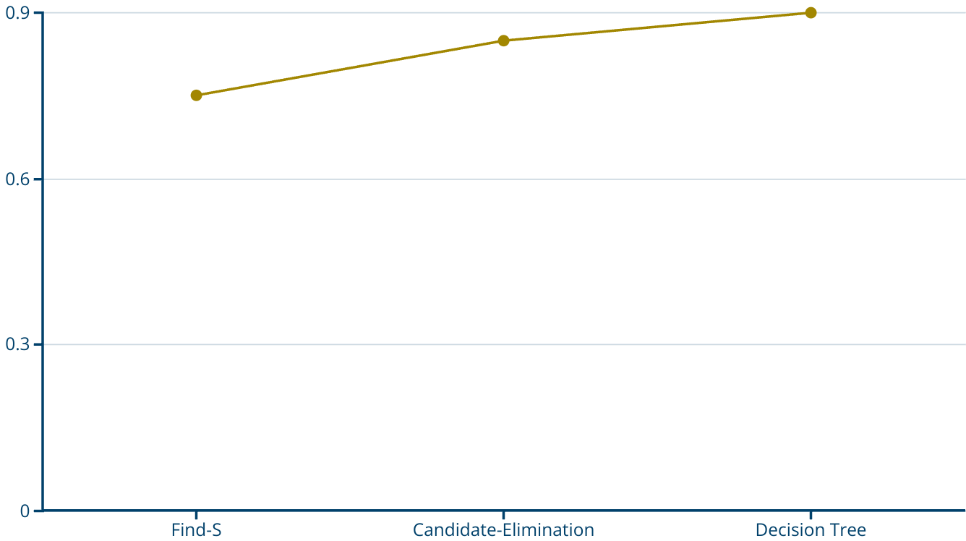
Charts: Performance Comparison of Algorithms
A comparison of algorithm accuracy shows Decision Tree has the highest accuracy. The line chart compares the performance of different algorithms. The Y axis presents an accuracy value.

Slide 20
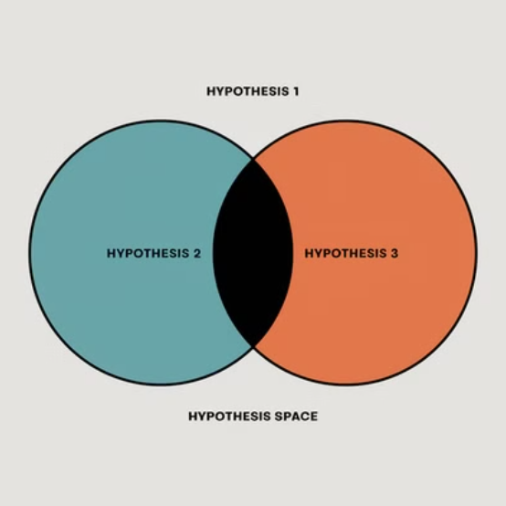
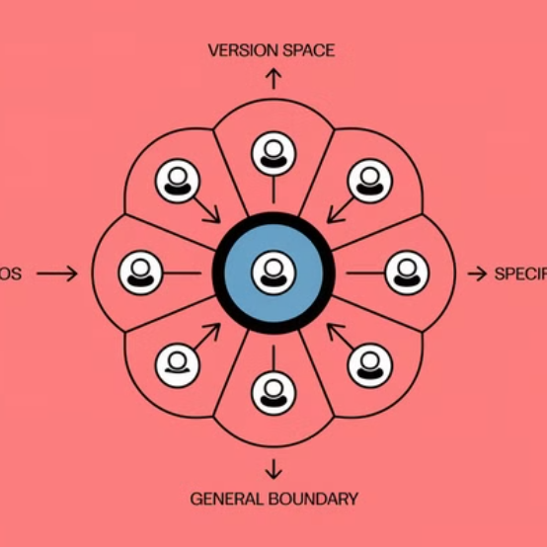
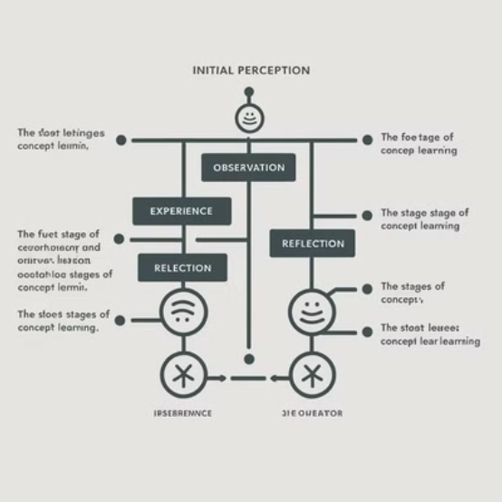
Diagrams: Visualizing Hypothesis Spaces
These diagrams depict the version space. Each represents a different way of visualizing hypothesis selection.

Slide 21

Summary: Key Takeaways and Future Directions
1
Rules
2
Algorithms
Knowledge can be represented as rules.
Algorithms for learning rules exist.
3
Applications
Concept learning has many real-world applications.

